Slide 1
Rossman Project
Team Awesome Incredible:
Avinash Kamath, Kyle bartsch, prateek bhadsavle

Slide 2
About the dataset

Slide 3
Rossman Dataset
Sales
Stores

Slide 4
Data Cleansing

Slide 5
Data Types
Many variables need to be converted to correct data types:
Integers -> Factors
Factors -> Dates
Factors -> Integers

Slide 6
Missing Values
Stores Dataset:
Competition Distance – only for 3 stores (81,862,957)
Competition Open Since Month / Competition Open Since Year – 317 stores
Affects Competition Open Date – if values are NA,
Promo2 Since Week / Promo2 Since Year – 486 Stores
Affects Promo2 – Appears if Promo2 = 0, it never was offered and the date values are truly unknown.

Slide 7
Imputing Missing Values
Competition Distance – May not be worth the time (3 stores)
No single other attribute appears to be predictive of Competition Distance
Perhaps we can use K-means clustering to find similar stores?
Then impute based on an average of Competition Distance of similar stores?
Competition Open Date – Highly missing, but may be predictive
No other attributes seem to be predictive of Open Date
Perhaps we can use K-means clustering to find similar stores?
Promo2 Start Date – No need
When Promo2 = 0, the promo was not offered

Slide 8
Feature Engineering

Slide 9
Features We Engineered:

Slide 10
Exploratory Data Analysis

Slide 11
Univariate EDA

Slide 12
Bivariate EDA

Slide 13
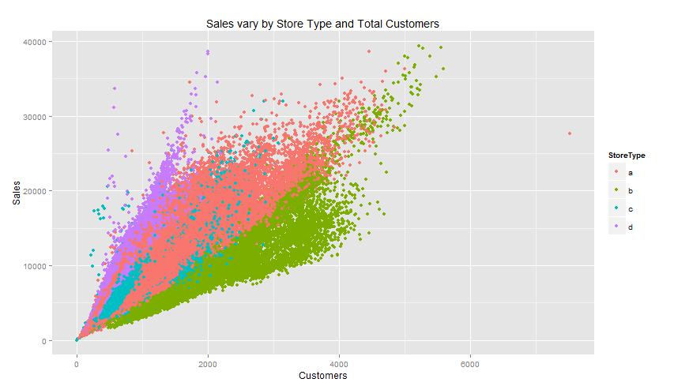
Sales vs. Total Customers/Store Type

Slide 14
Plans for data modeling

Slide 15
Modeling Techniques To Consider:
Traditional Linear Regression
Start with stepwise selection for dimension reduction
Determine optimal # of dimensions based on AIC
Add higher order terms?
Regression Trees
Start will all dimensions
Prune tree to find most parsimonious model
Bagging (Bootstrap Aggregating)
Use all dimensions – be wary of overfitting

Slide 16
Modeling Techniques To Consider:
Random Forest
# of dimensions (usually square root of # of dimensions)
Boosting
Parameter Tuning:
# of trees to build
Interaction depth
Shrinkage

Slide 17
General Modeling Parameters

